Slide 1
Public transport + carpooling + social media crowd sourcing
SocialCar
a Horizon 2020 project
1st MOVESMART Workshop
Renewable Mobility Services in Smart Cities:
Challenges, Approaches and Social Aspects
Luca Lucietti FIT | 15 October 2015

Slide 2

Our mission...
...is to leverage, popularise and mainstream the concept of a public-private integrative co-modal local transportation service...
for the benefit of...
...citizens, businesses and the efforts to obtain an optimal utilisation of local transport resources.

Slide 3
The project identity card
Project Title:
Project Acronym:
Grant Agreement:
Funding Scheme:
Starting Date:
Duration:
Open social transport network for urban approach to carpooling
SocialCar
636427
H2020-MG-2014
1st June 2015
36 months

Slide 4
The SocialCar team

Slide 5
Background
Why SocialCar?
Dominance of private car use and low car average occupancy rate.
Need of a less car-dependent lifestyle promoting more sustainable transport modes, including new forms of vehicle use and/or ownership.
Need of making private transport more efficient by changing mobility patterns and habits.
Existing transport-related data and information at city levels are still fragmented and urban transport information systems are unable to integrate them in a coherent way.
Need to exploit smart mobility approaches to carpooling in a practical, social and viral way, adding the possibility to link the carpooling service with existing collective transport services and other mobility options, enhancing the co-modality capability.

Slide 6
What is SocialCar
An innovative approach to transport demand management and specifically to carpooling in urban and peri-urban areas.
A new communication network for intelligent mobility, sharing information of car-pooling integrated with existing transport and mobility systems by means of powerful planning algorithms and integration of big data related to public transport, carpooling and crowdsourcing.

Slide 7
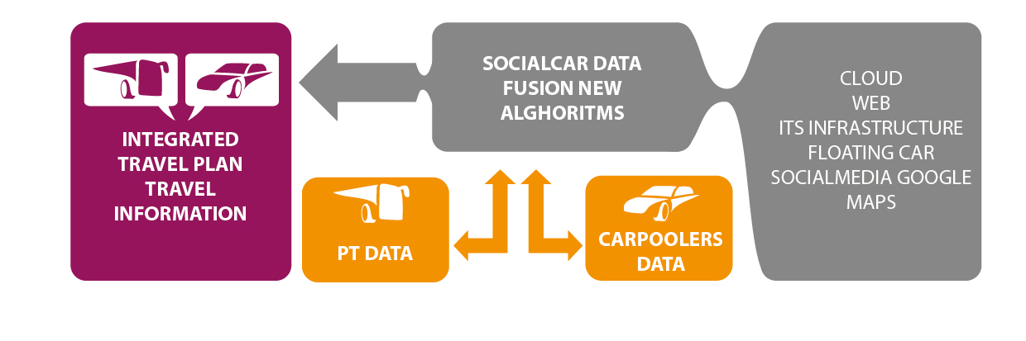
The SocialCar system

Slide 8
Objectives
Specific objectives of SocialCar
To develop a new carpooling model, targeted to optimise the inter-modality of carpooling with existing transport and mobility data and services within EU cities.
To enhance carpooling diffusion relying on widely used, easy to interact with communication channels.
To aggregate individual and spot mobility initiatives within an integrated multilingual citizen platform.
To identify suitable big data management architecture for integrating existing public transport data.
To maximise the availability of mobility data from different data sources.
To exploit potentials of the GNSS European technology.

Slide 9
The Workplan

Slide 10
SocialCar components and services
Back-end architecture
Service module for users’ registration
Data collection module (crowdsourcing transport data, open PT data)
Users data collection module (behaviours, preferences, etc.)
Module for integration of crowd and behavioural data
Module for elaboration and analysis of the different data sets
Dispatching module
GIS infrastructure module (transport supply, graph model)
Interface with all data (collection and elaboration)
Trip planning (trip calculation algorithms)
Ride matching and route planning algorithms
Traffic modelling
Tariff and payment module
Reporting module
Front-end application
Multi-channel user interface (web, app)
User registration
User profiling
Trip request (options, acceptance)
User data (behaviours, preferences, etc.)
Data on network situation (traffic, accidents, emergencies, deviations, etc.)
Payment

Slide 11
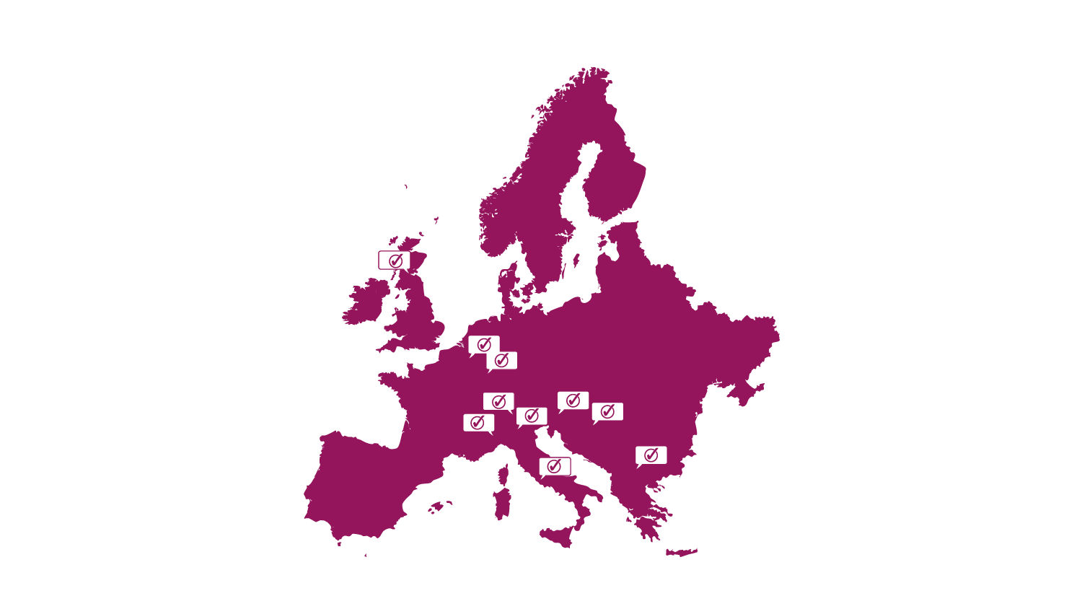
SocialCar test and validation sites
Brussels (BE)
Brescia (IT)
Canton Ticino (CH)
Edinburgh (UK)
Lazio Region (IT)
Ljubljana (SLO)
Luxembourg (LU)
Skopje (MC)
Turin (IT)
Zagreb (HR)

Slide 12
SocialCar expected results
Identification of barriers and areas for improvements and define market potential for an ITS based on car-pooling and public transport integration.
Integrated communication network architecture for urban smart mobility, including PT data, private transport data and real-time traffic information.
Sound management of big transport data (i.e. open data, real time data, static data, crowd source data, etc.) coming from different sources (private, public, open).
Real-time algorithms for trip planning and ride matching.
New user-friendly interfaces allowing effective exploitation of the service.
On site testing and validation of the SocialCar system in real-life conditions.

Slide 13
SocialCar expected impacts
Unlocked potential of big transport data, deployed within innovative environmental-friendly mobility solutions for EU citizens, alleviating congestion.
Improved quality of life in urban environments, through new mobility concepts.
Contribution to the EU 2020 targets on energy efficiency and renewable energy sources.
Improvements in collective Public Transport usage.
Environmentally and socially important impacts.
Demonstration of a ITS system based on car-pooling and collective transport.
Impacts related to EU policy implementation.

Slide 14

Thank you!
This project has received funding from the European Union’s Horizon 2020 research and innovation programme under grant agreement No 636427.
Luca Lucietti | lucietti@fitconsulting.it
www.socialcar-project.eu
@SocialCar_RDI

